Slide 1

Blockchain security vulnerabilities
CSE 508_Review paper
Shubhangi Garnaik (115268225)
Notes:
Good morning,
My topic for the review paper is Blockchain security vulnerabilities.

Slide 2

Brief introduction to Blockchain
Relatively new technology
Data are validated and added in certain blocks (a unit of the system with bundles of transactions)
Ensures trusted transactions, with principles of decentralization, cryptography and consensus of participants on the network.
Tamper proof - all will be notified of any change
Actively adopted by various domains like healthcare, real estate, etc.
Notes:
Blockchain
Relatively new tech
Data is validated and added in blocks(unit of the system).
Its based on principles like decentralization, cryptography and common consent of all participants to ensures trusted transactions
Is tamperproof, any changes made to existing block will be notified to all on the network
Actively adopted in various domains, as its known to be reliable

Slide 3
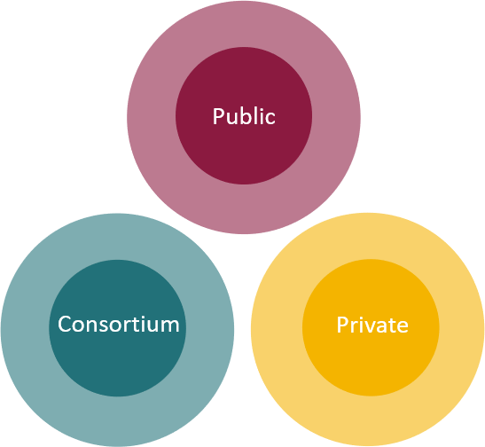
Blockchain types
Based on the permissions available to access data and network, various types of blockchains are as follows:
Private blockchain
Public blockchain aka Permissionless blockchain
Consortium blockchain
Permissioned blockchain
Notes:
Require permission/ invitation from network central administrator to join. Members identity must be confirmed before validating transactions.
Aims transparency, engagement from anyone and ensure anonymous participation. transaction on this network are validated with decentralized consensus
semi-permissioned method, which allows network to be distributed or partially decentralized, allowing a degree of control. pre-approved by a central authority to get involved in the consensus
limited to select only a set of users, who are granted identities via certificates.

Slide 4


Actual attacks on blockchain technology
Applications that use blockchain technology have been severely attacked and suffered financial losses at a large scale.
Code Exploitation - biggest crowdfunded project DAO ( Decentralized Autonomous Organization)
Stolen keys - Bitfinex (bitcoin exchange platform) loss of 72 million dollars
Employees computer hacked - Largest Ethereum and bitcoin cryptocurrency firm, Bithumb system was hacked, compromised 30,000 user data and losses of 870,000 USD worth bitcoin.
Notes:
exploits the protocol design or programming errors in the blockchain code - eg. integer overflow vulnerability - DAO smart contract hacked to rob of 60 million dollars
private keys aka the personal digital signatures are compromised - Nearly 120,000 units of digital currency bitcoin worth about US$72 million worth bitcoin
Employee of Bithumb was hacked, that led to compromise 30,000 users’ data and 870,000 USD worth bitcoin was stolen.

Slide 5


Types of attacks
51% attack - attackers disguised as miners, attain more than 50 % mining power- collect hash rate, control system, modify transactions and prevent it from being confirmed
Phishing attack - attain credentials, lead to financial and personal information loss
Routing attack - hackers intercept data in transfer, users unaware if discrepancies
Sybil attack- attacker creates false network nodes, flood and crash the system, get majority consensus and disrupt transactions
Notes:
more than 50% of power they can have control over the ledger and manipulate. Can reverse previously completed transactions, resulting in spending twice
Attackers aim to attain one’s credentials, thus cause financial loss.
Trust real time large data transfers, hackers intercept the data as it transfers to the internet service providers
create and use many false network node identities to flood a network and crash a system

Slide 6

Mitigate Attacks
51% attack :
Check mining pool monitoring
Raise hash rate values
Avoid proof of work or decentralized consensus
Phishing attacks:
Verified add ons to browser and notify for unsafe ones
Malicious link detection software, reliable antivirus
Don't click on a link, istead enter url on browser and check
Have the system and software up-to date

Slide 7


Mitigate Attacks
3. Routing attacks:
Use secure routing protocols and valid certificates
Use data encryption
Use strong passwords and change them regularly
Be aware and let other know about the hazards
4. Sybil attacks:
Use suitable consensus algorithms
Monitor all node behavior on the network
Check nodes that only forward block

Slide 8

Conclusion
We discussed various possible attacks on blockchain technology.
Attacks occurred in major companies that use the technology.
Different ways to mitigate these attacks.

Slide 9
Thank you
Q?

